Slide 1
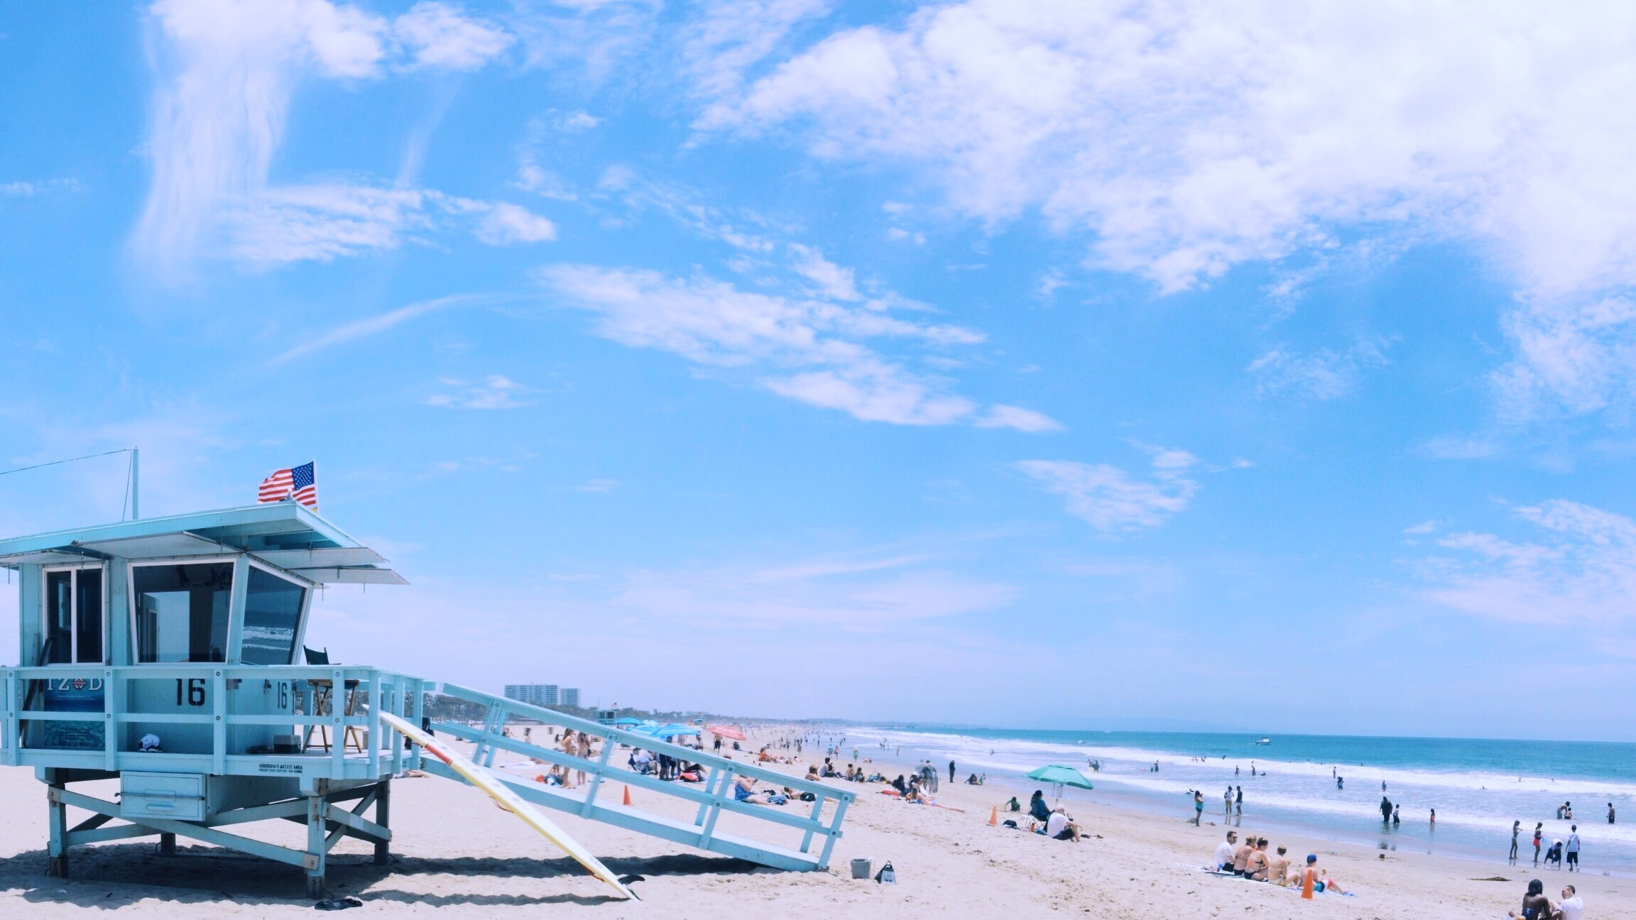
How to Memorize Faster
Learning is a gradually process

Slide 2
PART.01
Remember 15 words

Slide 3
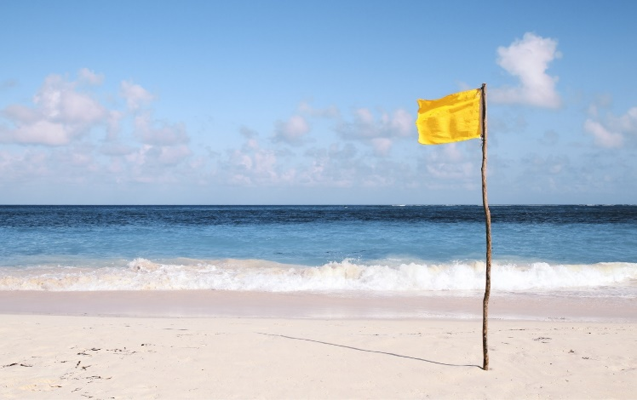
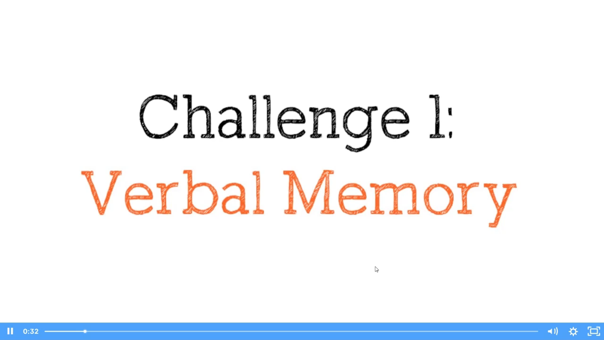
Remember 10 words

Slide 4
Remember 10 words
Piano
Elephant
Truck
Bottle
Basketball
Chair
Pineapple
Dog
Painting
Trampoline

Slide 5
PART.02
Visual Remember

Slide 6
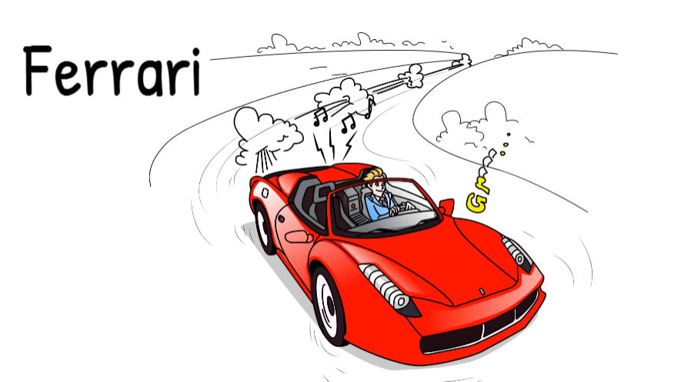

Slide 7
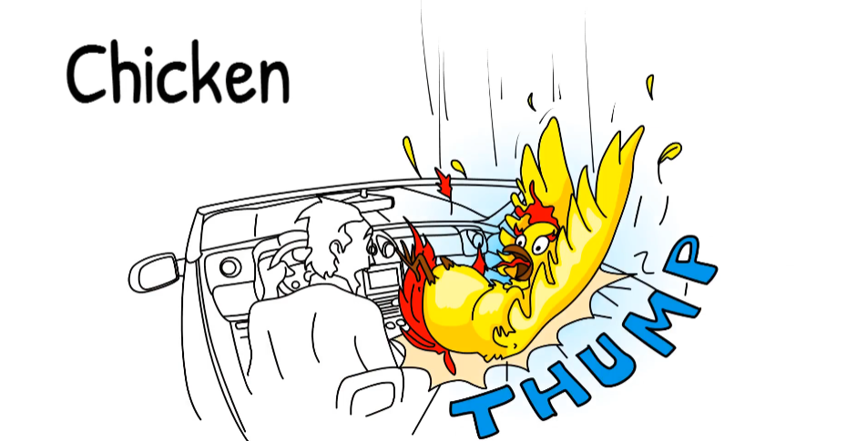

Slide 8
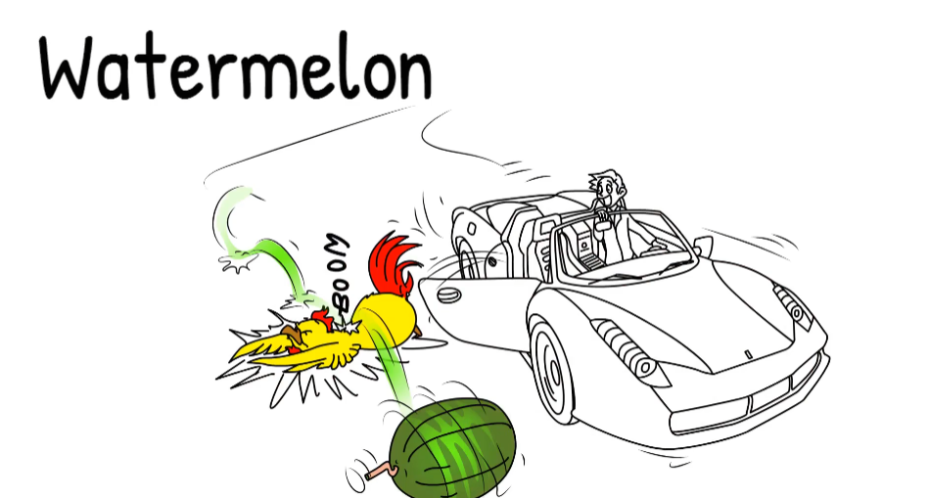

Slide 9
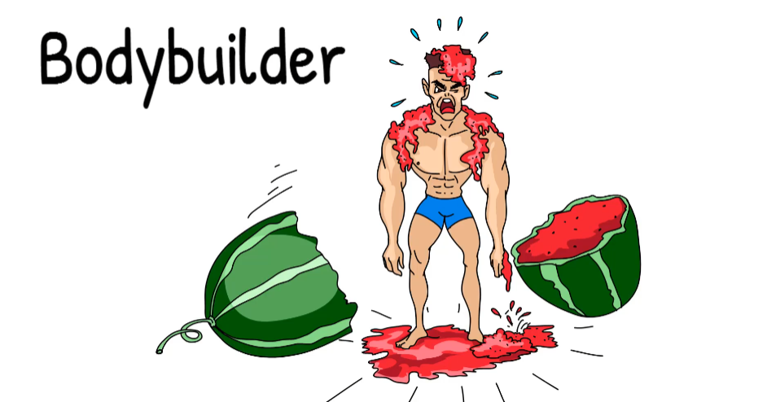

Slide 10
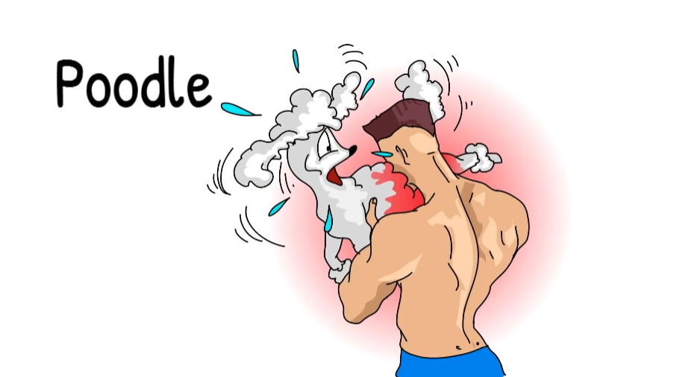

Slide 11
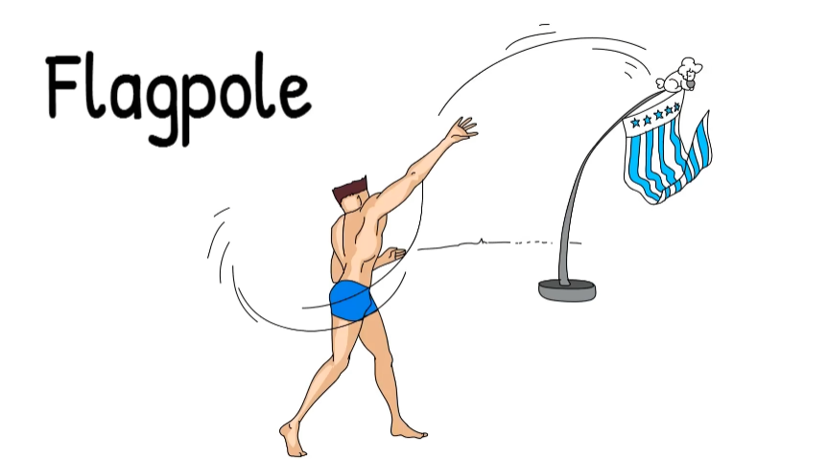

Slide 12
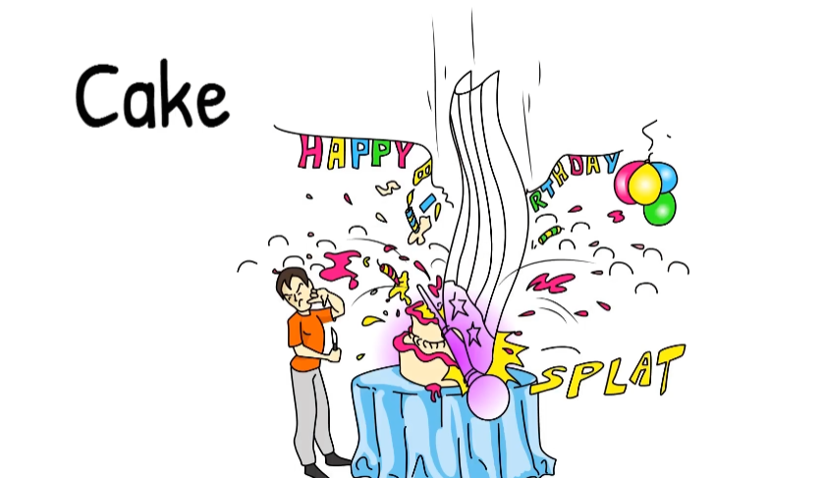

Slide 13
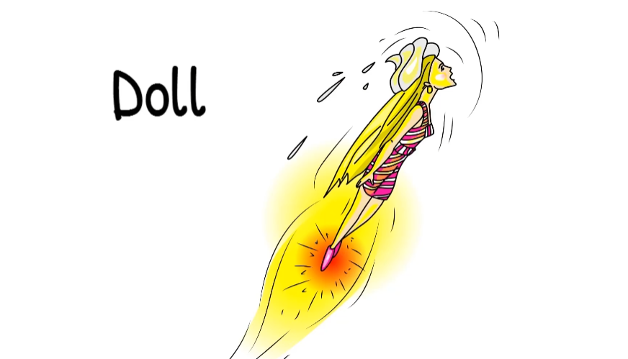

Slide 14
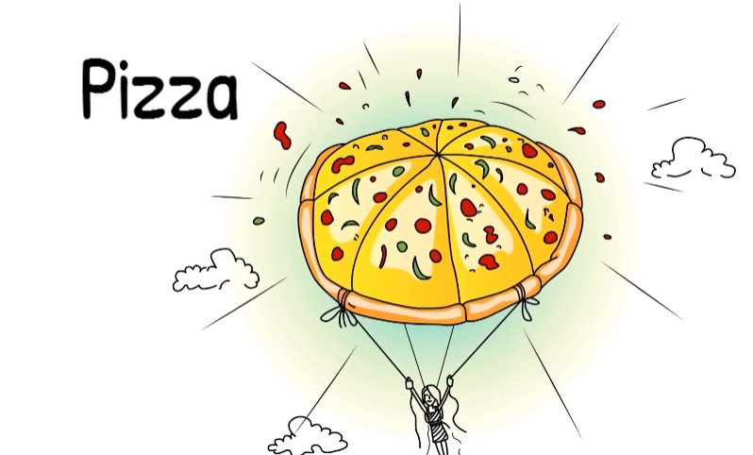

Slide 15
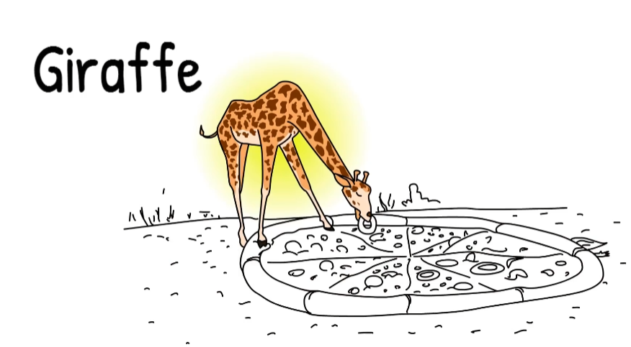

Slide 16
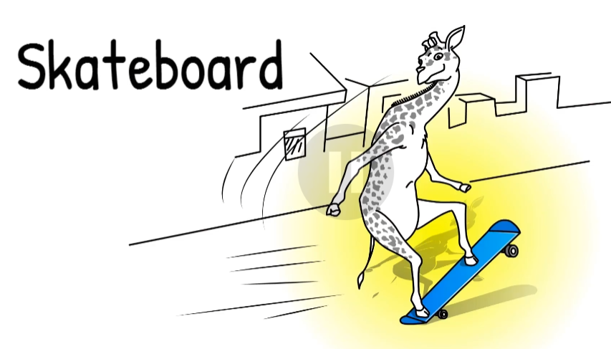

Slide 17
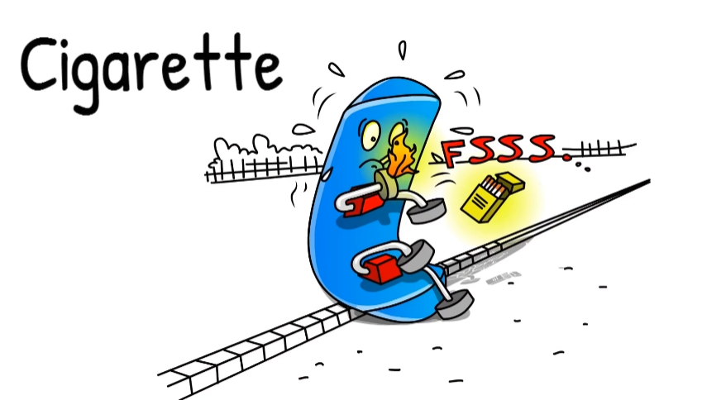

Slide 18
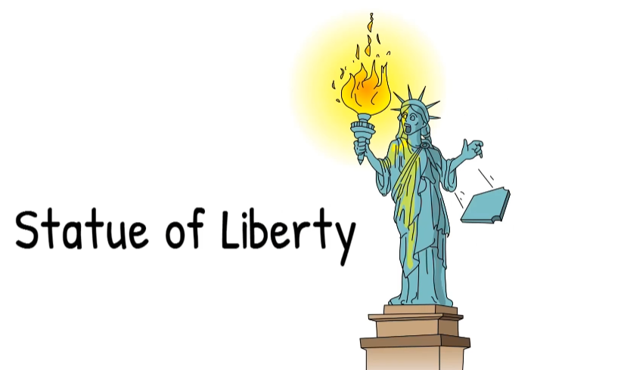

Slide 19
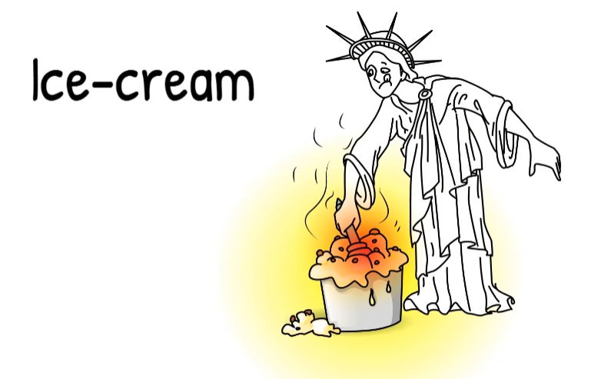

Slide 20
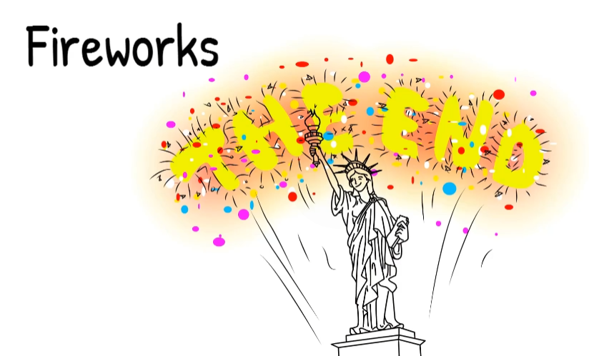

Slide 21
THANK YOU
There was no cloud in the air. There was no wind. There was only a hot sun overhead. All the trees stood idly and lazily.

